Slide 1
Metal Forming

Slide 2
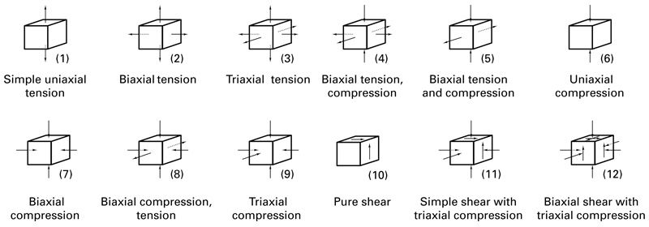
Classification of States of Stress

Slide 3
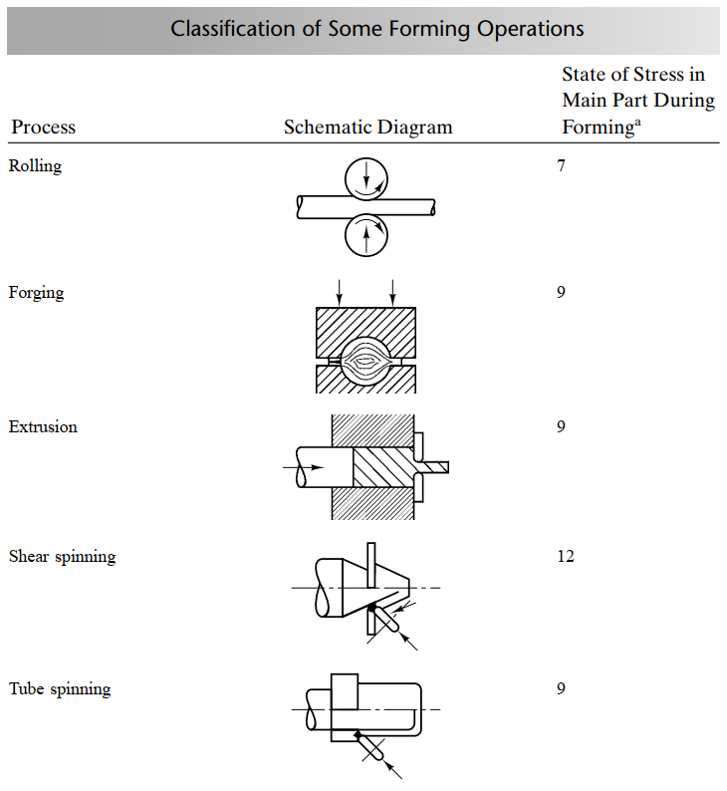
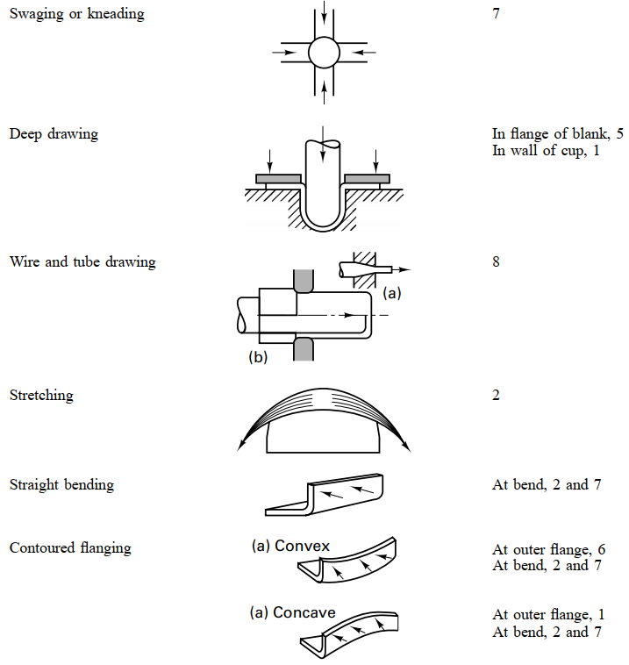
Classification of Some Forming Operations
ªNumbers correspond to those in parentheses of previous slide’s table.

Slide 4
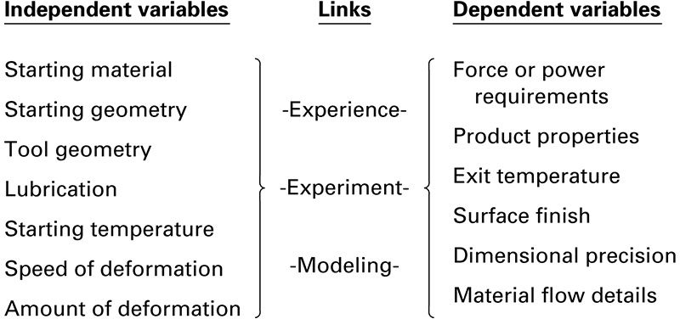
Independent and Dependent Variables Linked

Slide 5
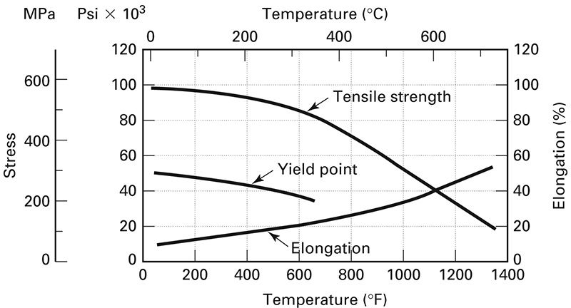
Effects of Temperature

Slide 6
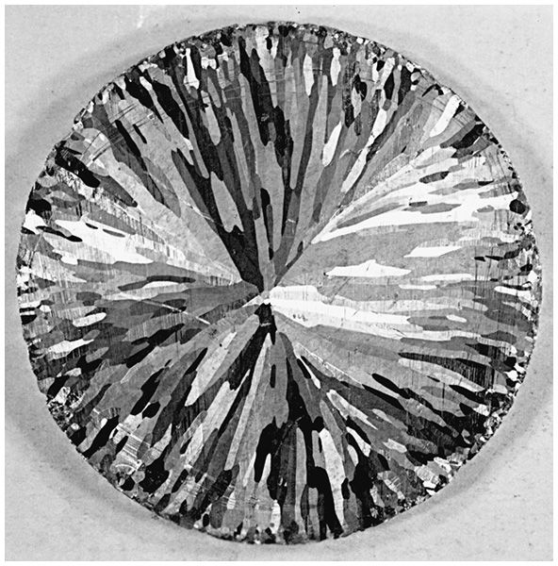
Cast Structure

Slide 7
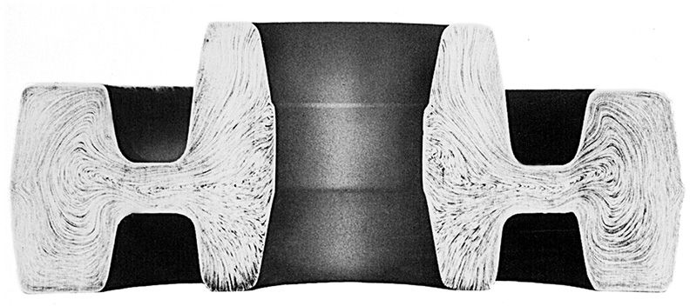
Flow Structure

Slide 8
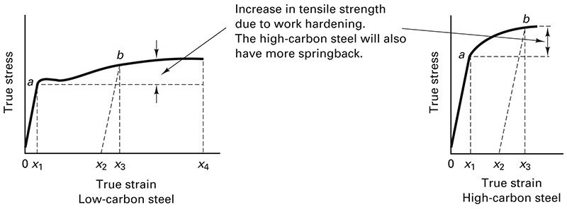
Springback

Slide 9
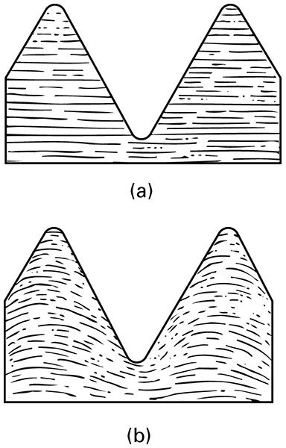
Machined vs. Rolled Threads

Slide 10
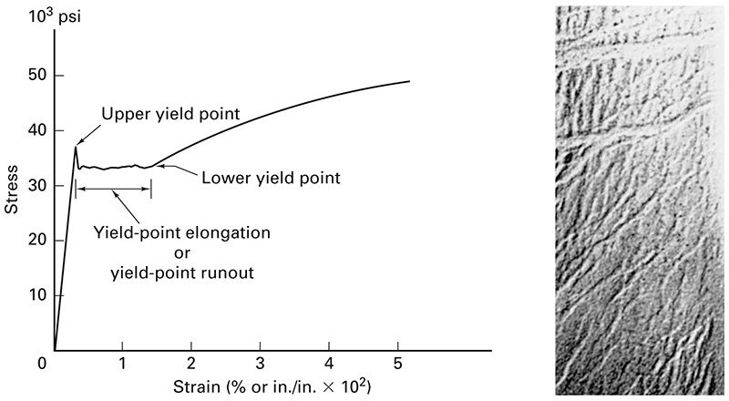
Luders Bands

Slide 11
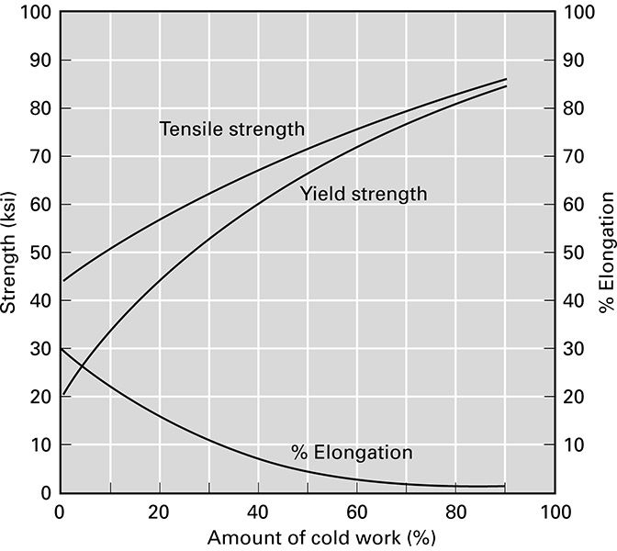
Mechanical Properties vs. Cold Work

Slide 12
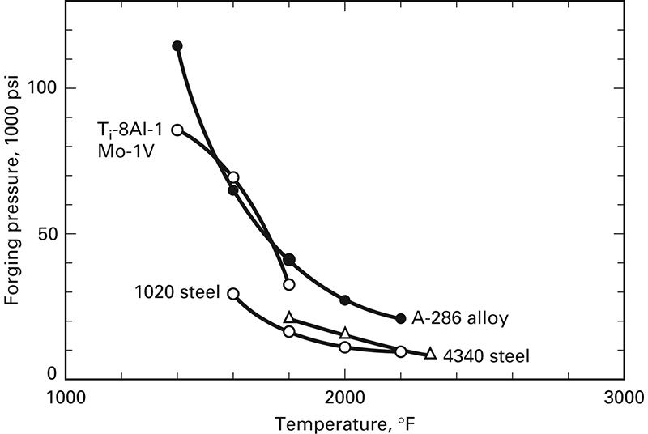
Yield Strength vs. Temperature

